Slide 1


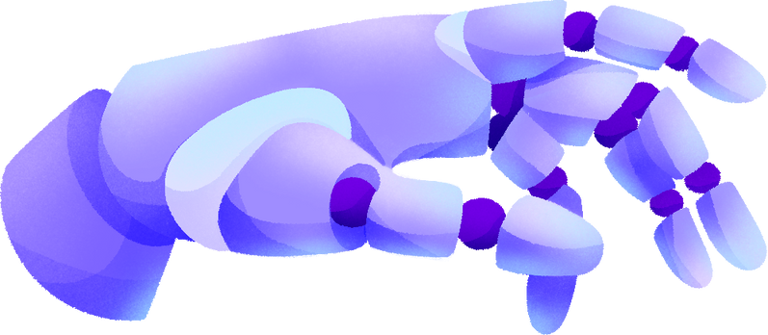
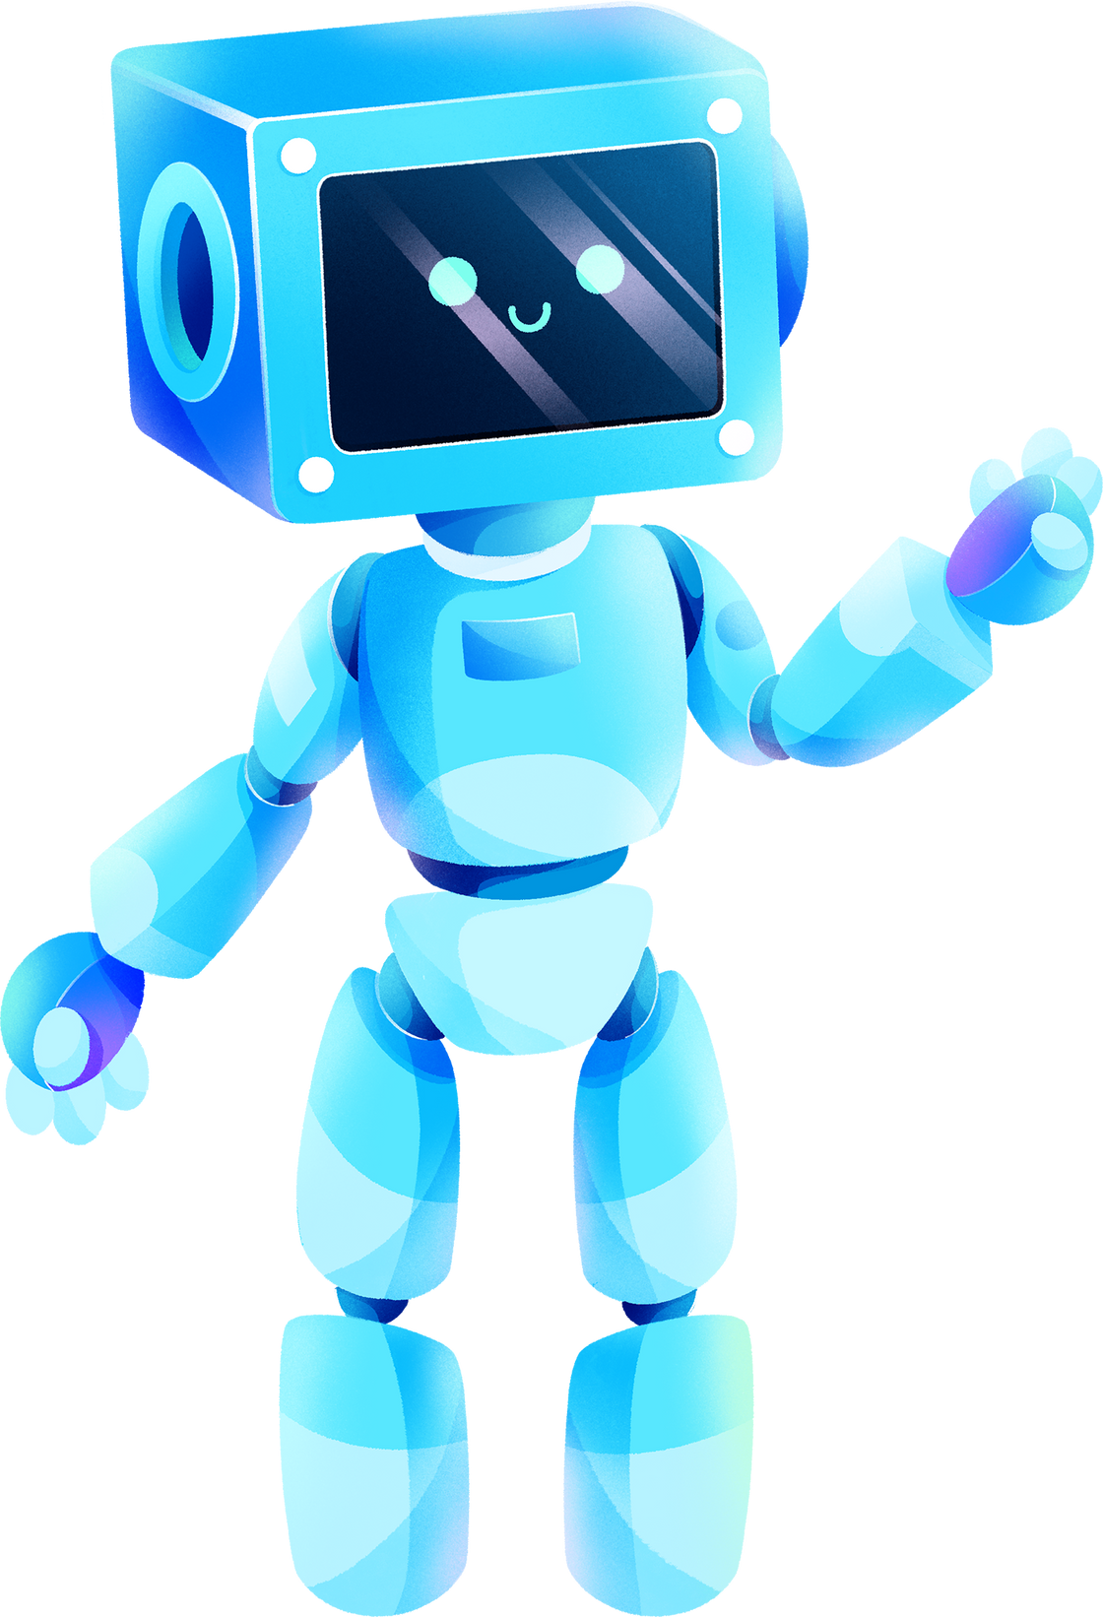
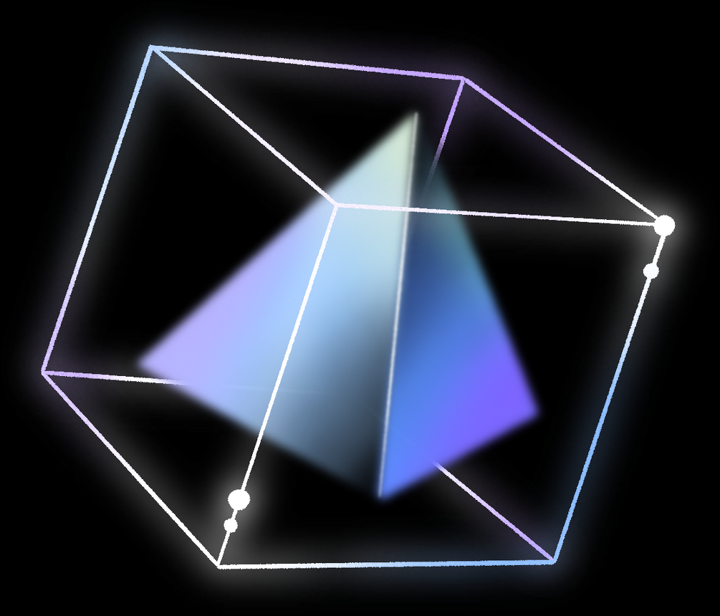
A PERSONALIZED CHATBOT FOR MUMA
BULLBOT
By Team Maverick

Slide 2
A BRIEF OVERVIEW
The Most Important Question - WHY AI?
Project Objectives
What it BullBot?
What it isn’t
What it could be...

Slide 3

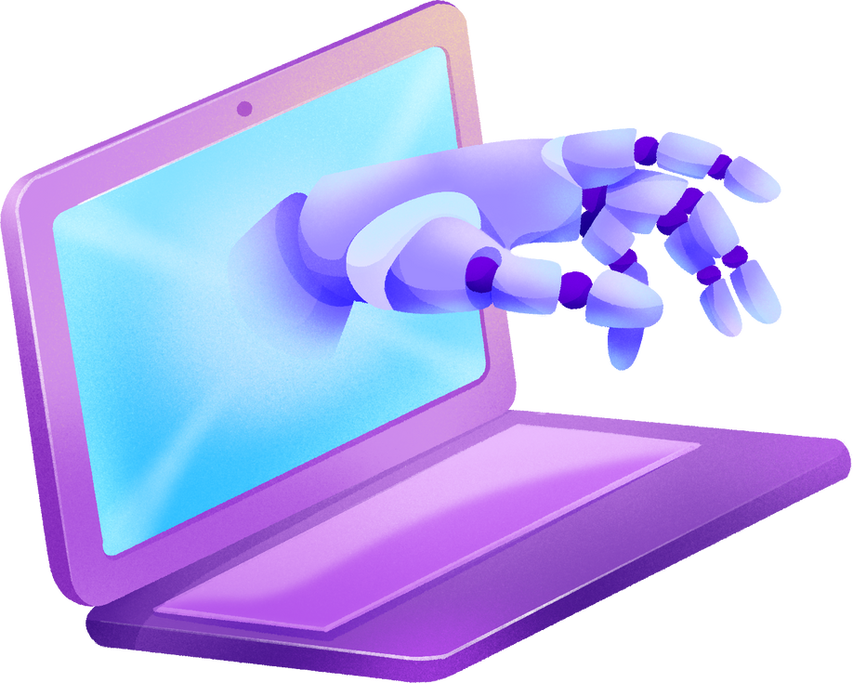
WHY AI?

Slide 4
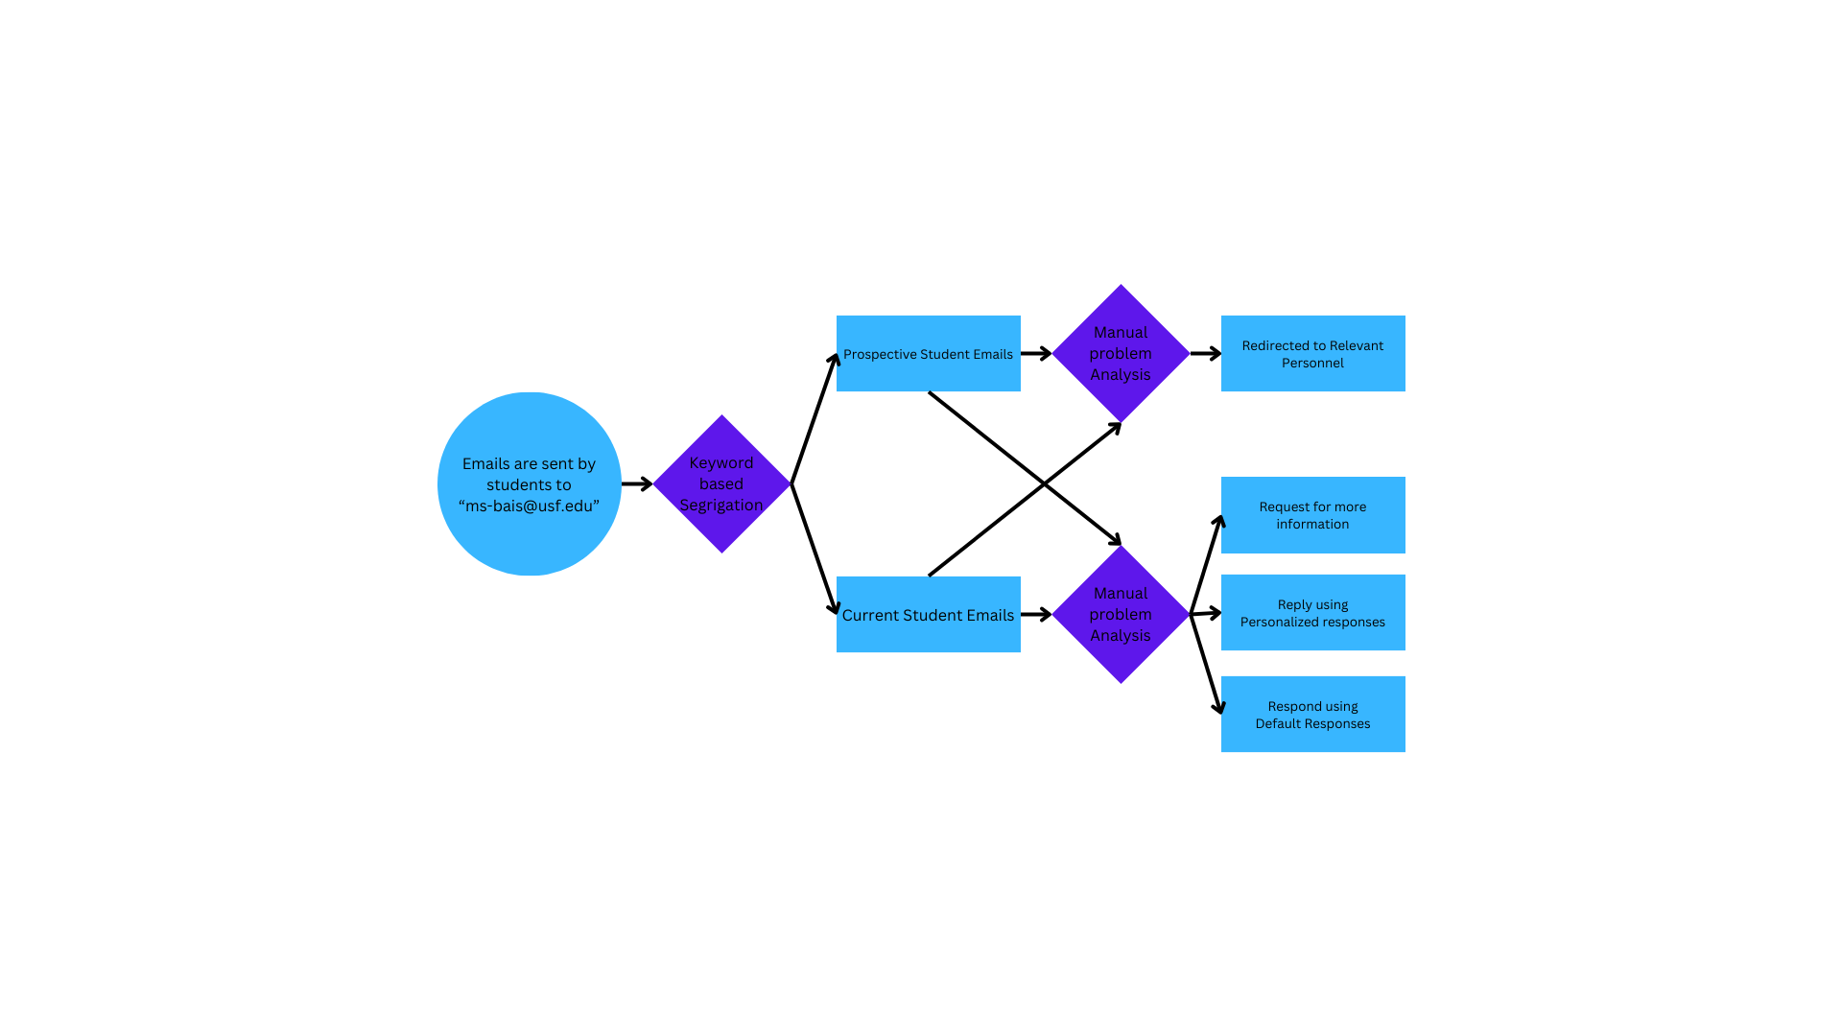
CURRENT PIPELINE

Slide 5

PAINPOINTS
01
02
03
Necessary information is not being provided in the emails
The solution to the query is available on USF Website
or
Canvas Current Student Portal
The volume of information is very high for students to look through

Slide 6
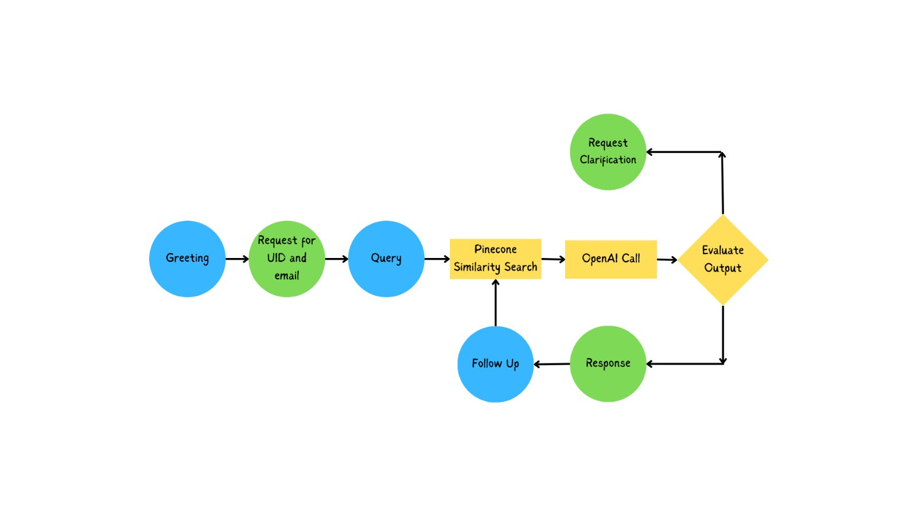
CHATBOT PIPELINE

Slide 7
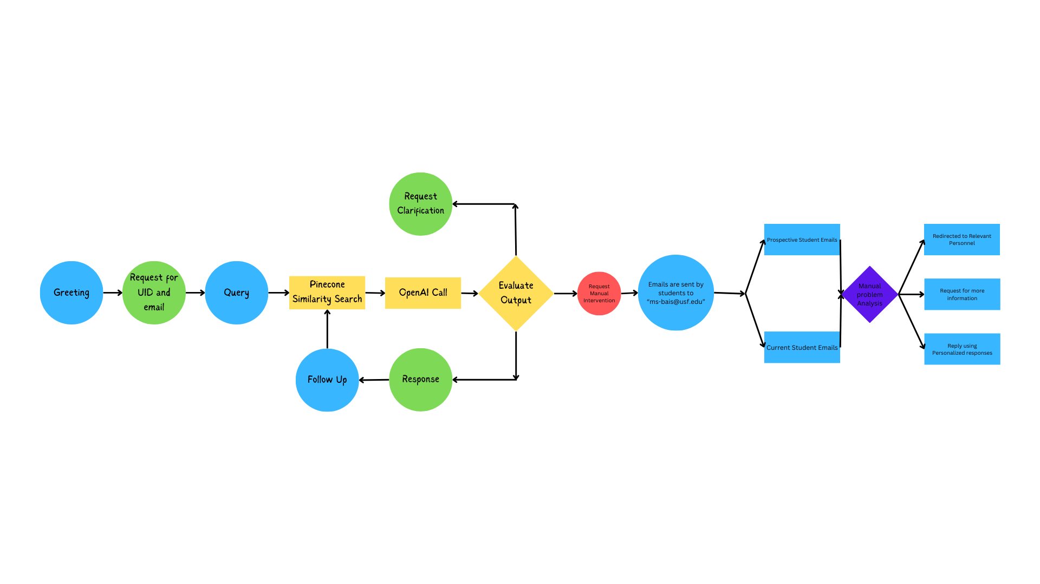
UPDATED PIPELINE

Slide 8







WHAT IS BULLBOT?
FRIENDLY
FAST
WELL INFORMED
By integrating OpenAIs GPT3.5/GPT 4,
We were able to make a friendly and personable Chatbot
The average response time for each interaction is less than 1 minute
Trained using a Corpus of:
Over 2200 Web Pages
More than 5000 Previous Conversations
Over 300 Syllables Documents

Slide 9
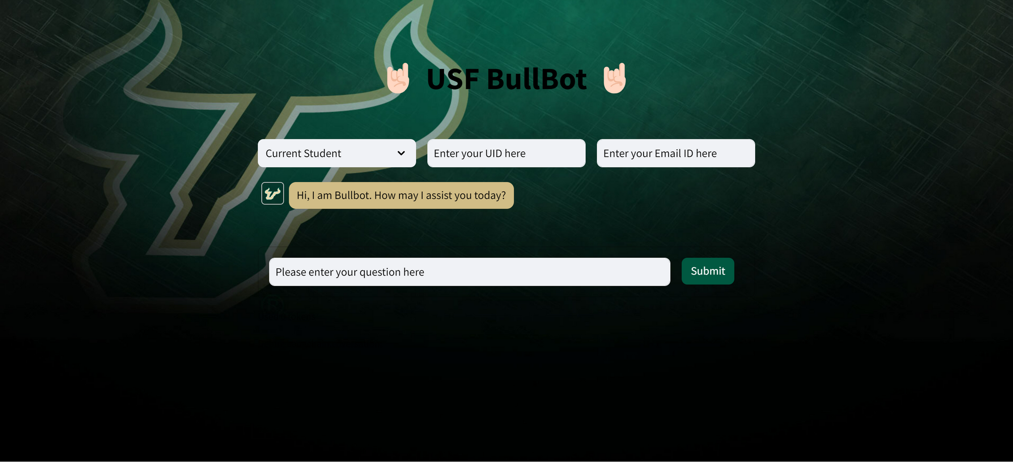
THE INTERFACE

Slide 10
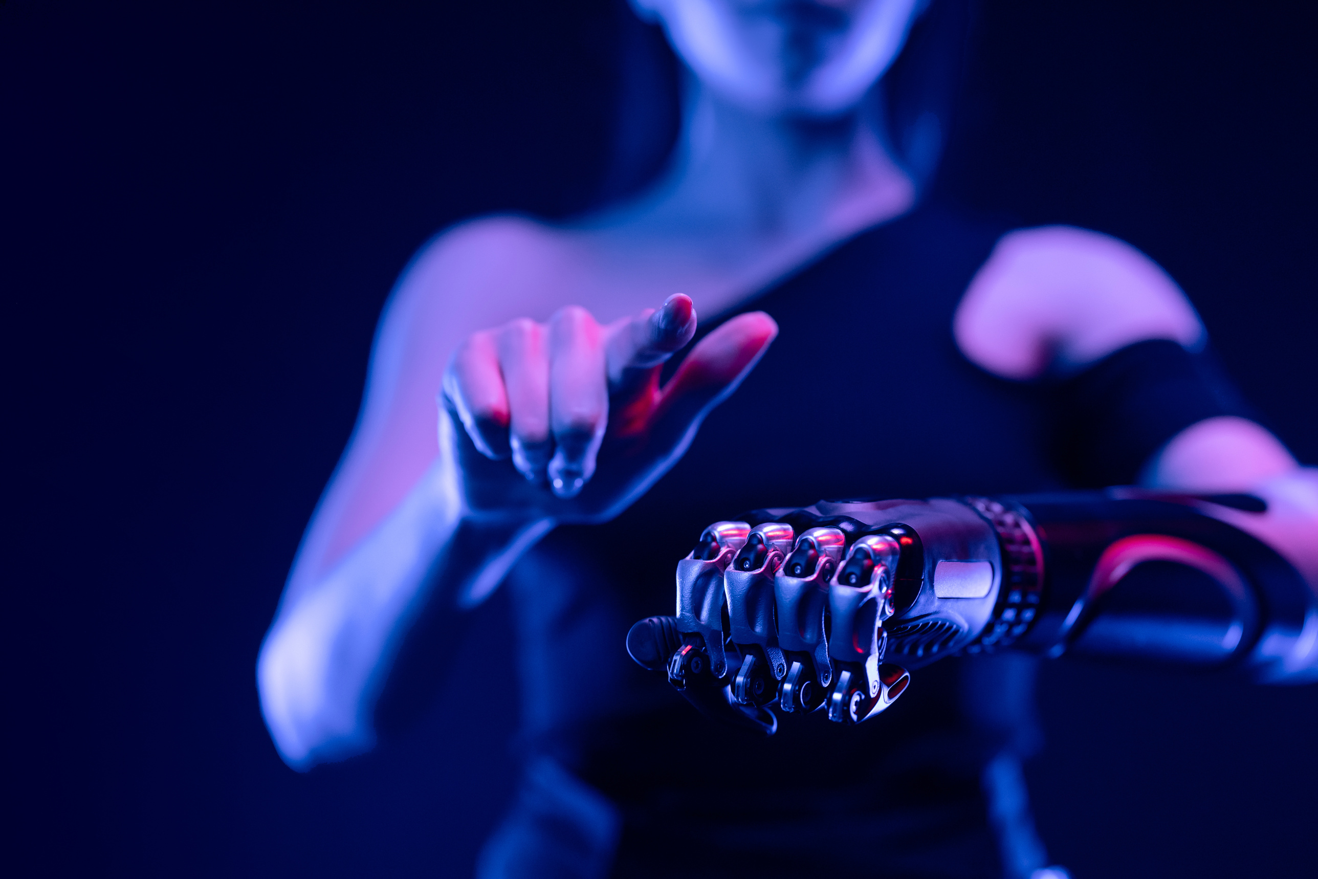



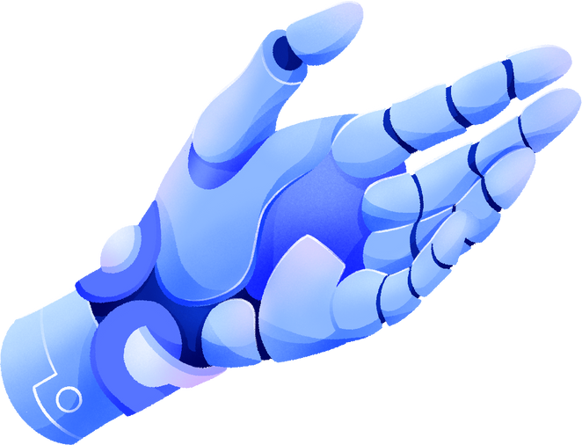
TECHNICAL ARCHITECTURE
Primary Code: Python
LLM: GPT 3.5/GPT 4
Vectorization: Pinecone

Slide 11
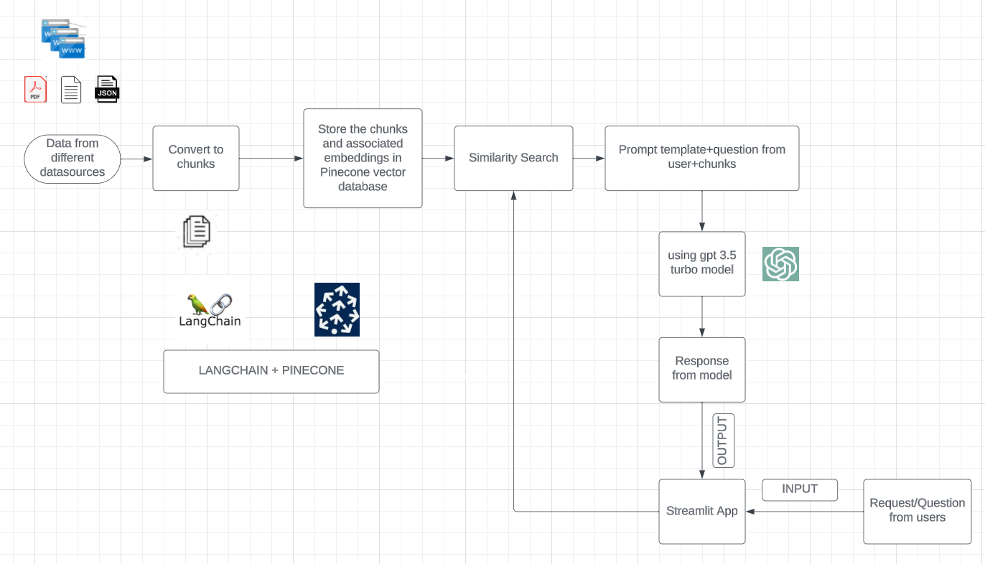

Slide 12
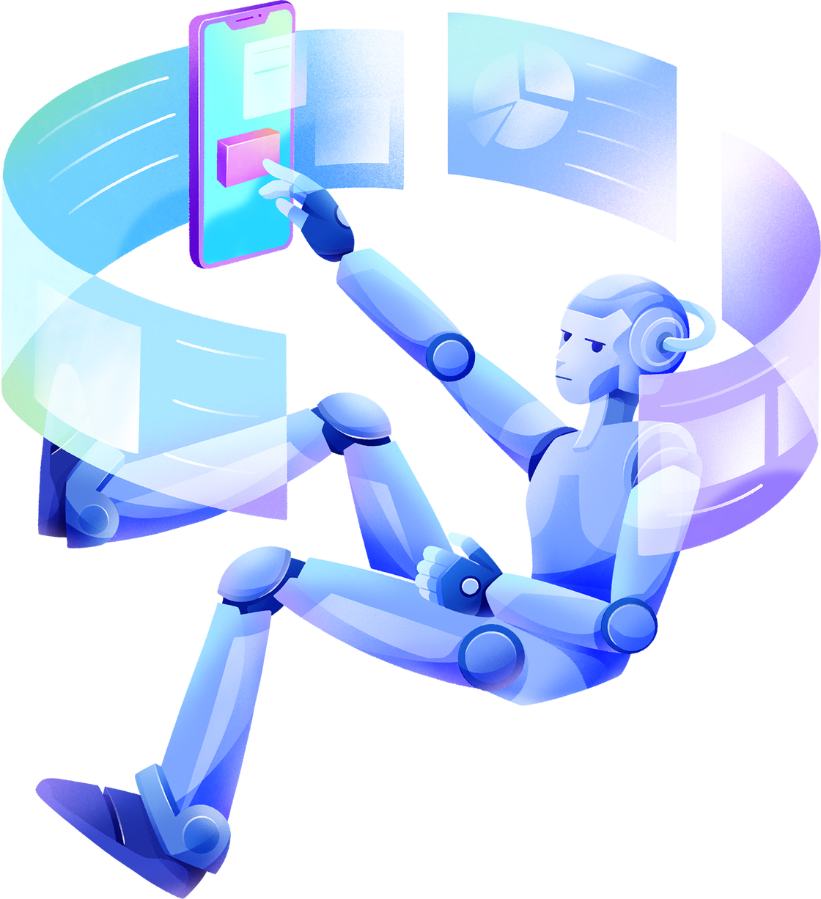

A
LOT
OF EMBEDDING AND TESTING LATER...

Slide 13




OUTCOMES
Since it is mandatory for students to provide their UID and Email ID before asking queries, the problem of missing necessary information is significantly reduced.
01
02
BullBot claimed it could answer 1/3rd of the questions posed to it previously.
03
BullBot is proficient in a large and dense corpus of information, making it easier for students to enquire and gain information.

Slide 14
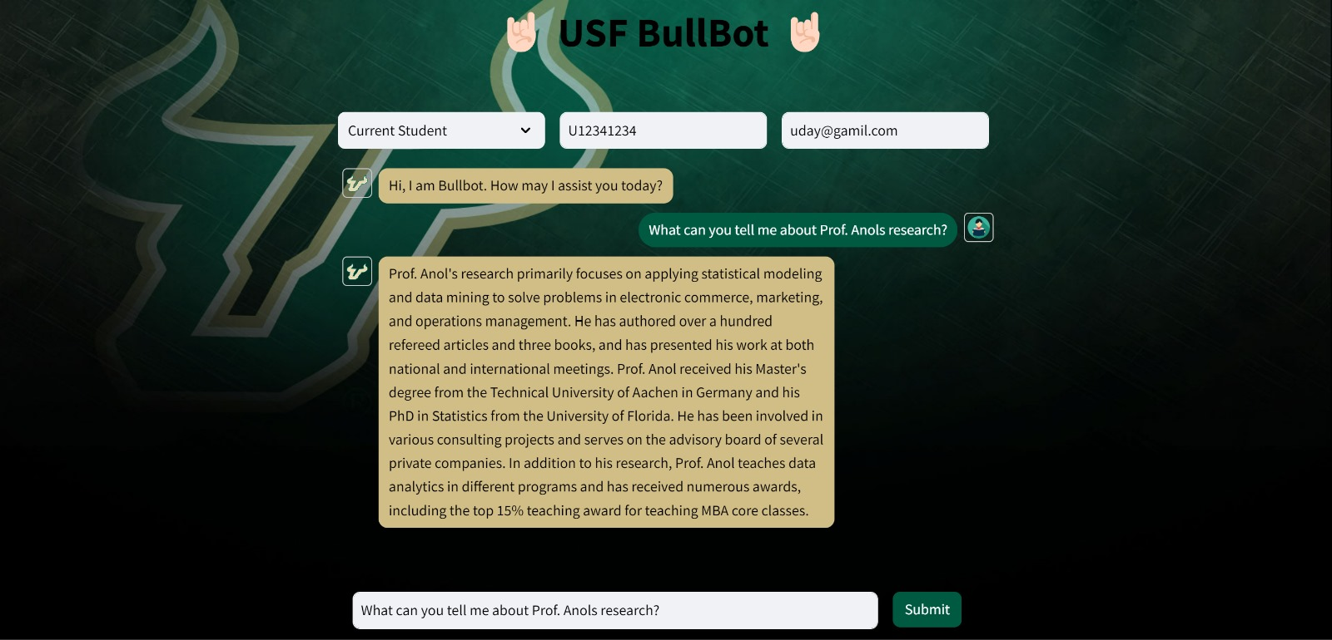
HE IS VERY CLEVER

Slide 15
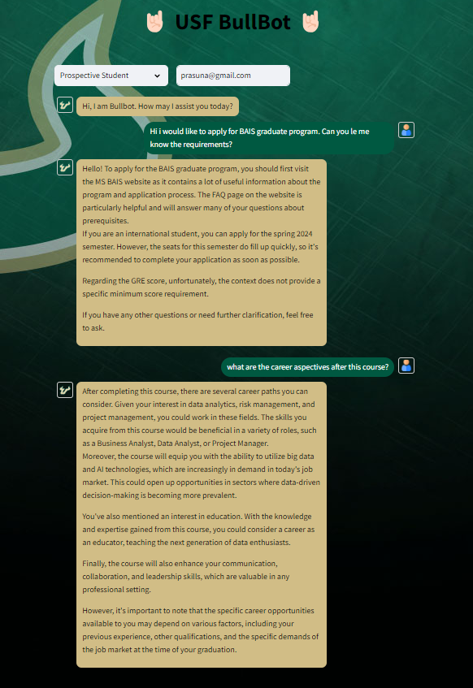
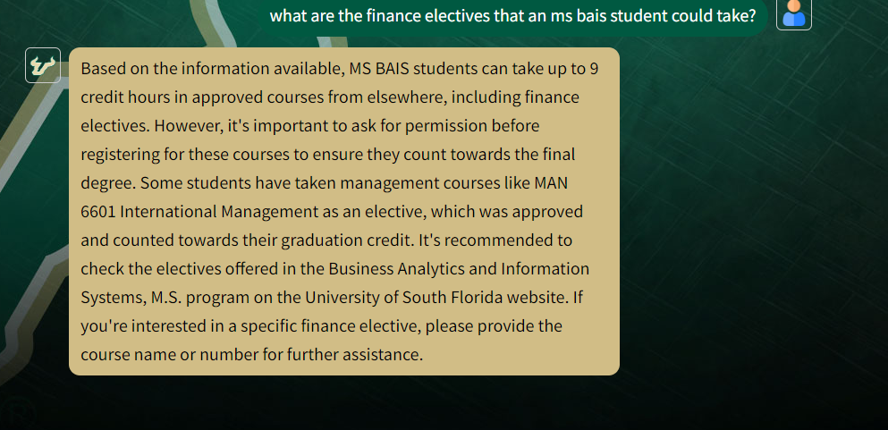
IT CAN GET SPECIFIC

Slide 16
WHAT IS IT NOT!
INFALLIBLE
LIABLE
AUTONOMUS
Like all LLMs, Bullbot is gullible and susceptible to hallucinations
There is no mechanism in place to evaluate inaccurate/outdated information
While it greatly reduces the workload, human intervention is definitely required.

Slide 17
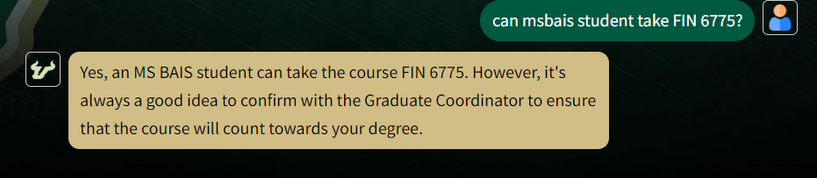
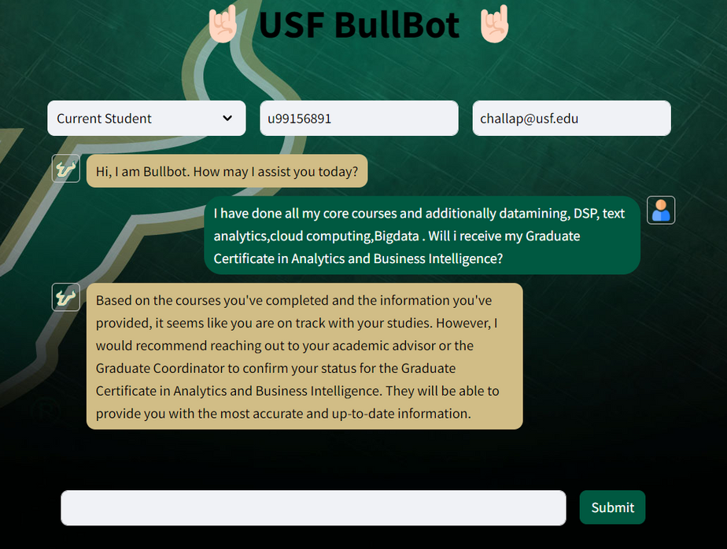
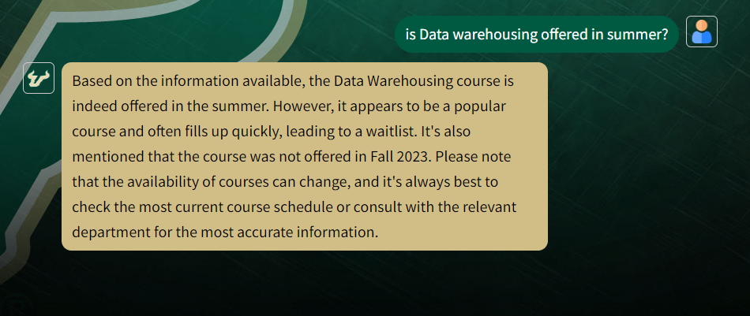
IT KNOWS ITS LIMITATIONS

Slide 18

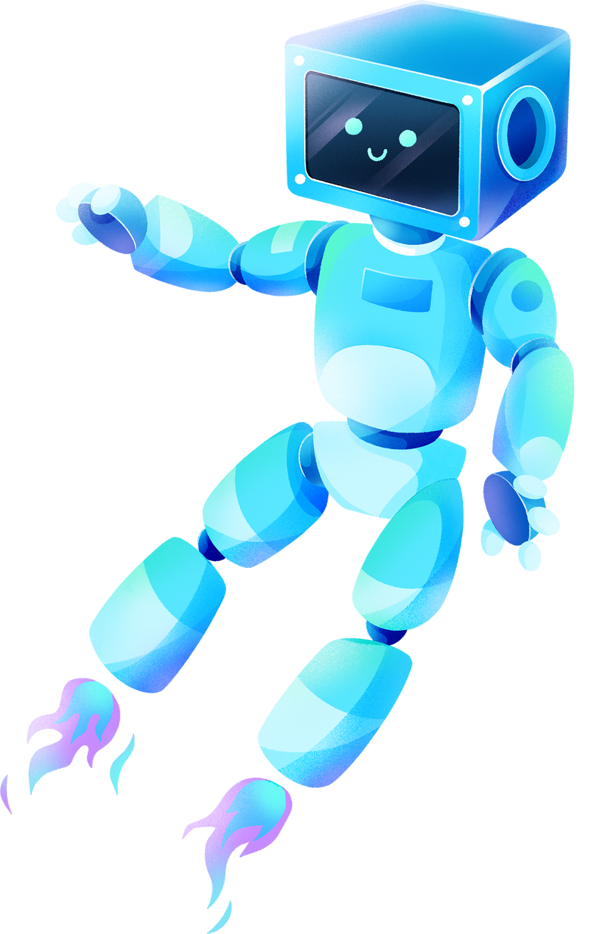




SCOPE FOR THE FUTURE
CONTINUOUS LEARNING
INCREASED EFFICIENCY
AUTOMATION
ENHANCED ACCURACY

Slide 19
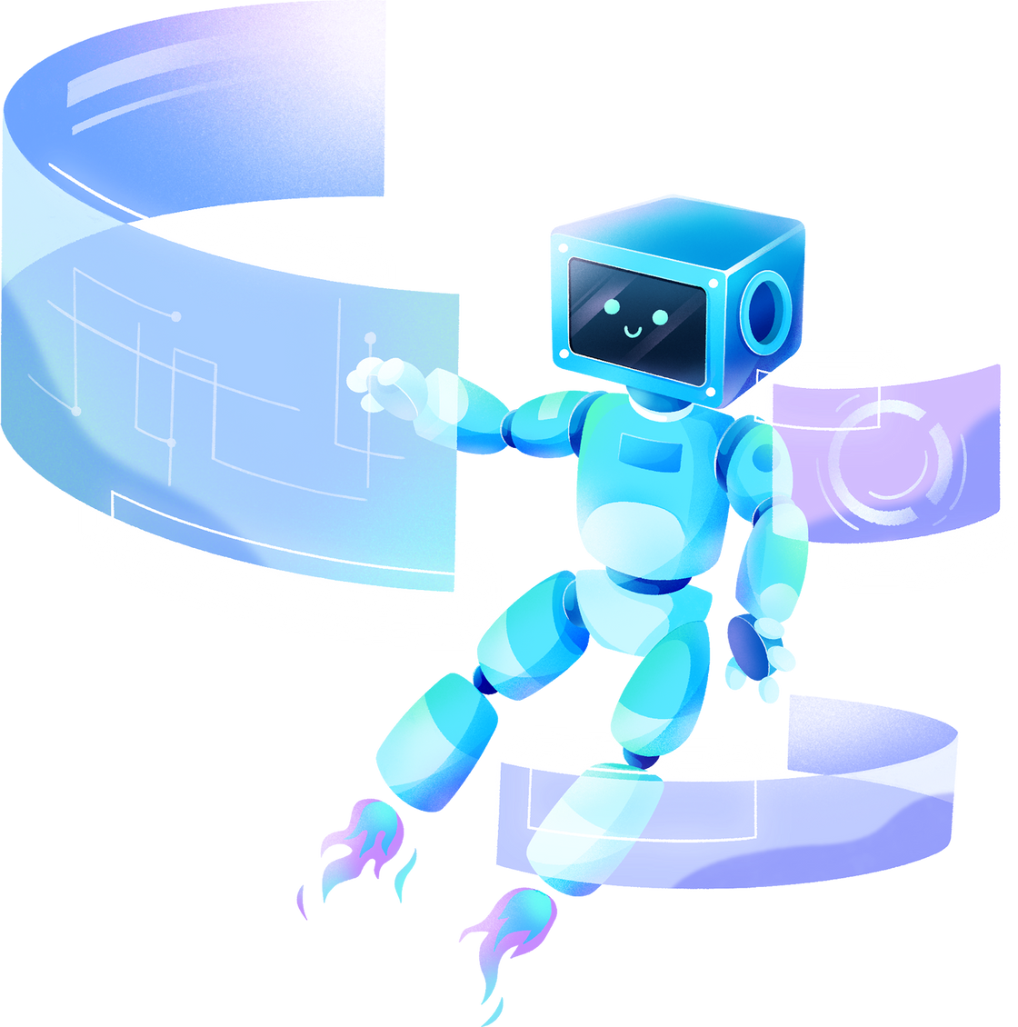
THANK YOU!

